Slide 1

Lab 1: Deploy a Web Application on AWS
~ 30 minutes

Slide 2





Lab 1 Scenario
In this lab, you will create AWS resources in order to launch a pre-made web application. These services include:
AWS IAM
Amazon EC2
Amazon VPC
Amazon S3
Amazon DynamoDB
Notes:
In this lab, you will launch a web application on Amazon EC2. The application will use Amazon S3 and Amazon DynamoDB for data storage.

Slide 3


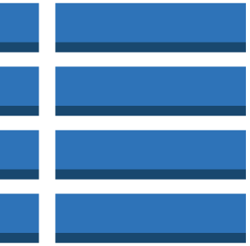


Lab 1: Tasks
Create an IAM Role
Create an Amazon S3 Bucket
Create an Amazon DynamoDB table
Create an Amazon VPC
Launch an Amazon EC2 instance with User Data
Access the application

Slide 4





Lab 1: Final Product
~ 30 minutes
User
Internet Gateway
Role
Web server
DynamoDB table with application data
Amazon S3 bucket with image assets
Public Subnet 1

Slide 5
Pictures for Lab Guide

Slide 6
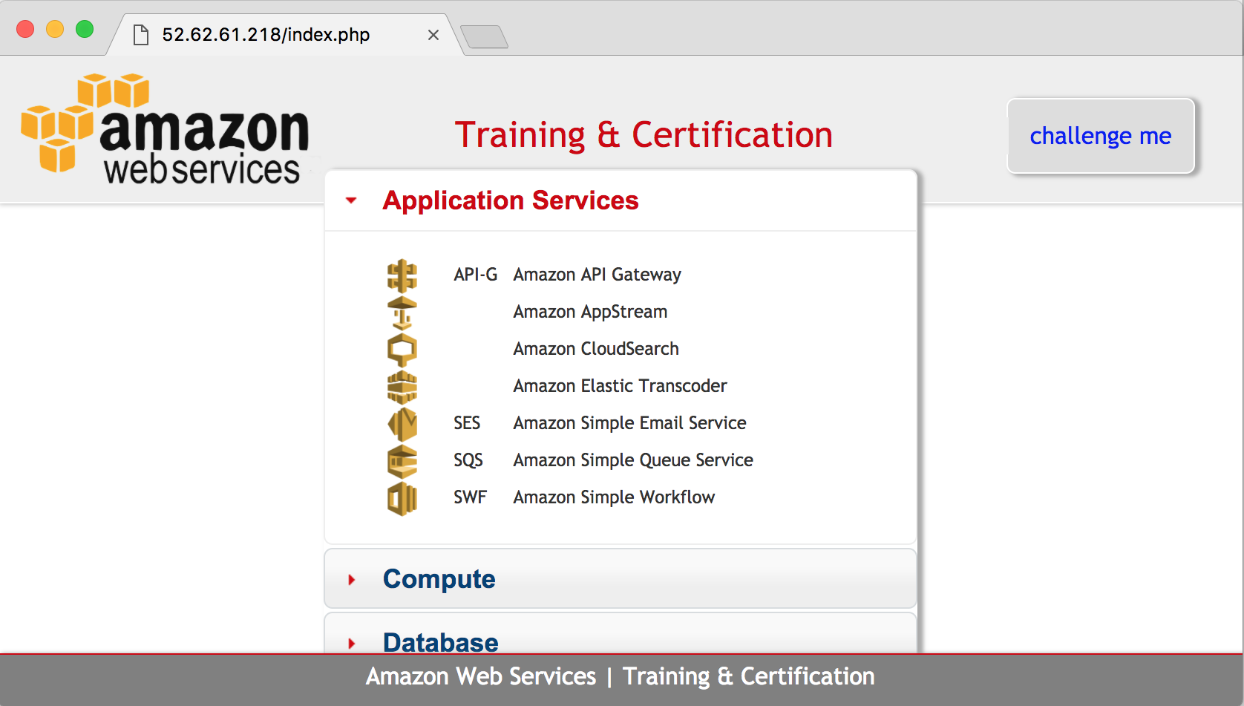

Web application on Amazon EC2 uses PHP
Images served from Amazon S3
Data retrieved from DynamoDB

